Slide 1
Data Collection and Analysis Agri-food sector
Regression Analysis

Slide 2
Table of contents
01
02
03
04
05
06
Overview
EDA
Compare Model
Project Overview and objectives
Exploratory Data Analysis
Regression Models
Evaluate Models
Insights
Conclusion
You can describe the topic of the section here
You can describe the topic of the section here
You can describe the topic of the section here

Slide 3
01
Overview
You can enter a subtitle here if you need it

Slide 4
Purpose
Analyze FAO and IPCC data on GHG emissions from the agri-food sector to understand its impact and develop climate change mitigation strategies.

Slide 5
Key Data Components
Farm Gate Emissions: Direct emissions from agricultural activities.
Land-Use Change: Emissions from deforestation and land conversion.
Pre- and Post-Production Processes: Emissions from food manufacturing, transportation, retail, and waste disposal.

Slide 6
Global Trends
2020: Agri-food systems emissions were 16 billion tonnes CO2eq (31% of total GHG emissions).

Slide 7
Regional Variations
Oceania: 71% farm-gate emissions.
Asia: 50% farm-gate emissions.
Africa: 44% land-use change emissions.
Europe: 53% pre- and post-production emissions.

Slide 8
Mitigation and Adaptation
Transform agri-food systems with climate-smart practices, better water management, and reduced food waste.

Slide 9
Data Analysis Approach
Data Preparation:
Exploratory Data Analysis (EDA):
Modeling and Evaluation:
Conclusion and References:
Importing Packages, Loading Data, and Data Cleaning.
Visualizations and summary statistics.
Feature Engineering, Modeling, and Model Performance.
Summary of findings and sourcing information.

Slide 10
Project Objective and goals
Understand the impact of agricultural activities on climate change.
Develop strategies for sustainable practices.
Use a comprehensive dataset from FAO and IPCC.
Explore various emission sources.
Perform regression analysis to predict temperature variations.
Offer actionable insights for stakeholders.

Slide 11
02
EDA
Exploratory Data Analysis

Slide 12
Approach
Exploratory Data Analysis (EDA) is the process of examining datasets to summarise their main characteristics. It often involves visualisations and summary statistics to uncover patterns, identify anomalies, and test hypotheses.

Slide 13
EDA tasks
Tasks | Descriptions | Timeline
Task A | You can add a description here | 1 week
Task B | You can add a description here | 2 weeks
Task C | You can add a description here | 3 weeks
Task D | You can add a description here | 4 weeks

Slide 14
About the data
The dataset “co2_emissions_from_agri” was collected from FAO and IPCC.
Emissions from the agri-food sector significantly contribute to global annual emissions.
Understanding and addressing these emissions is crucial for mitigating climate change and promoting sustainability.
The dataset includes various emission sources such as savanna fires, forest fires, crop residues, and rice cultivation.
It also covers emissions from activities like pesticides manufacturing, food transport, and food processing.
Features include total emissions, average temperature increase, and population data.
Forestland is noted for its negative emissions due to its role as a carbon sink.And the most important thing: the audience won’t miss the point of your presentation

Slide 15
Data Characteristics
The Dataset contains :
6965 rows
31 columns, of which:
Area is type object (categorical)
Year is type int64 (categorical, time series)
Remaining 29 columns are type float64 (numerical)
Several columns have a Non-null Count < 6965

Slide 16
Data Cleaning Analysis
Noted the following during the analysis
Column names have a mixed case and will need renaming
Need to understand units of measurement for different columns, non-standardised data
Some columns with zero values - drained organic soils, net forest conversion, fires in organic soils, fires in humid tropical forests
There are several features for which there is not enough data (more observations have zero values than not)
Eleven of the 29 numeric columns contain nulls.

Slide 17
Data Cleaning Actions
Column names have been standardised as follows:
Lower snake case
remove units of measurement like degrees celsious or co2
remove dashes ‘-’
These features were dropped:
drained_organic_soils
fires_in_organic_soils
fires_in_humid_tropical_forests
Updated the null values to zero

Slide 18
Insights
Correlation analysis
total_population_female and total_population_male perfectly correlated, remove...
manure_management and manure_applied_to_soils highly correlated - remove...
DISCARD
manure_management (correlated with manure_applied_to_soils)
food_packaging (correlated with food_household_consumption, food_processing)
food_processing (correlated with food_packaging, food_household_consumption)
total_population_male (total_population_female)

Slide 19
03
Models
Visualisation of models used in EDA

Slide 20
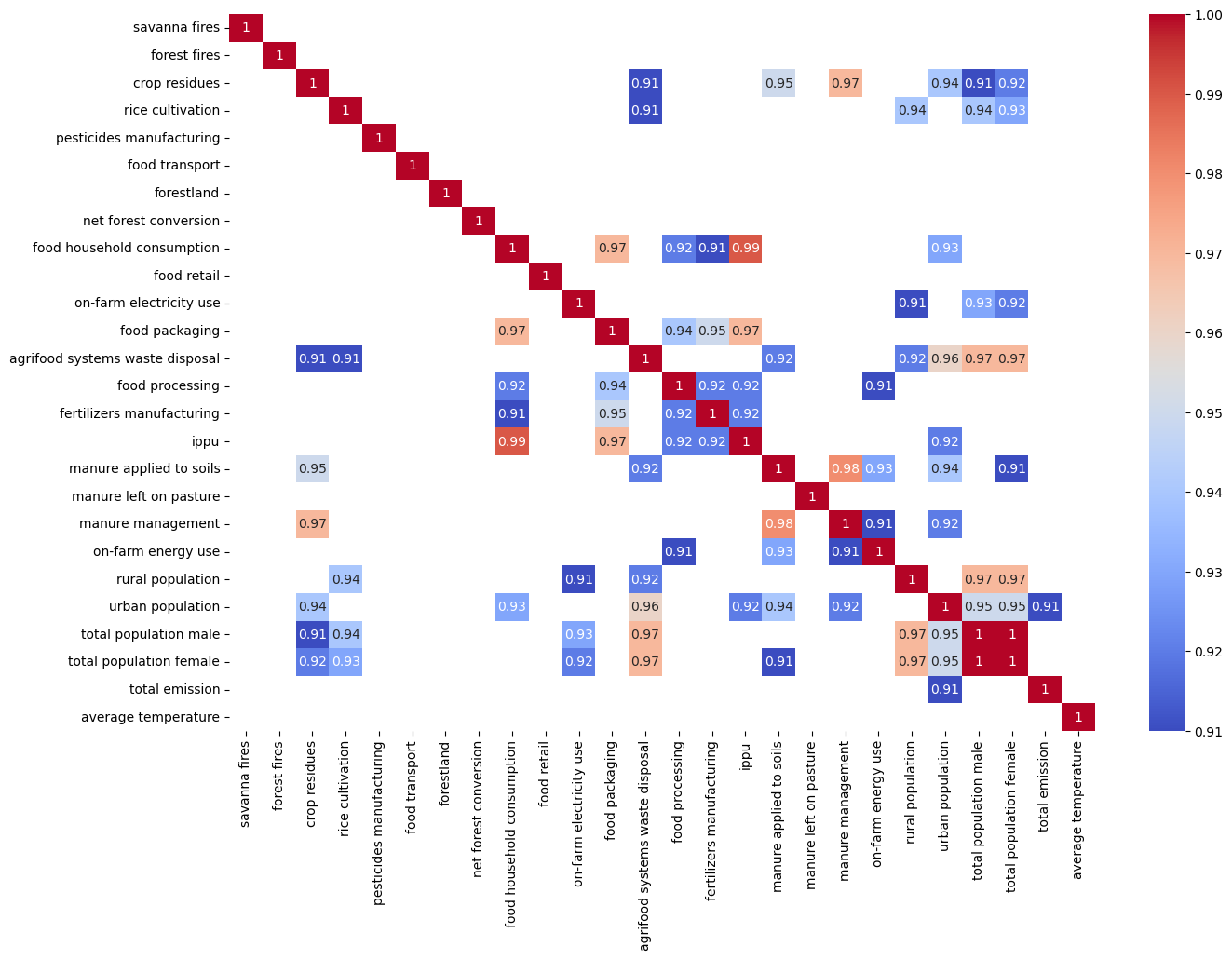
Correlation Matrix
Mercury
Mercury is the closest planet to the Sun and the smallest of them all
Venus
Venus has a beautiful name and is the second planet from the Sun

Slide 21
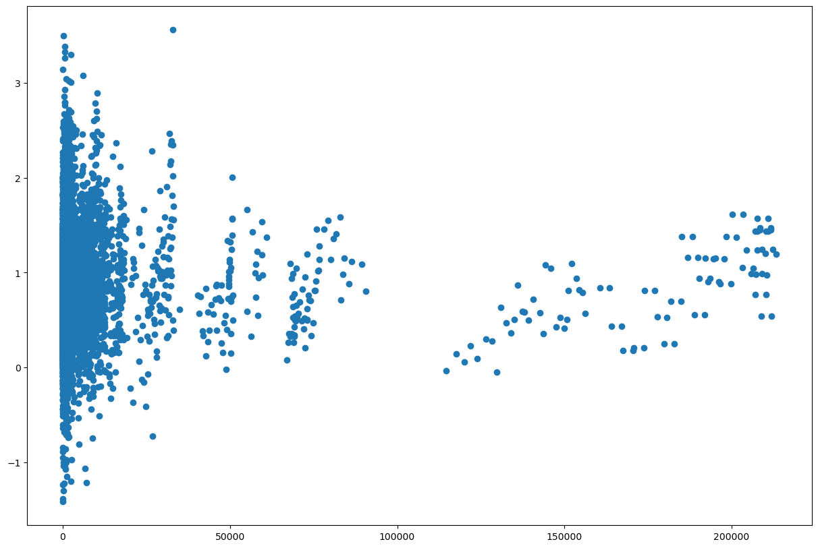
Scatter Plot Diagram
Average Temp
Reflects that ???

Slide 22
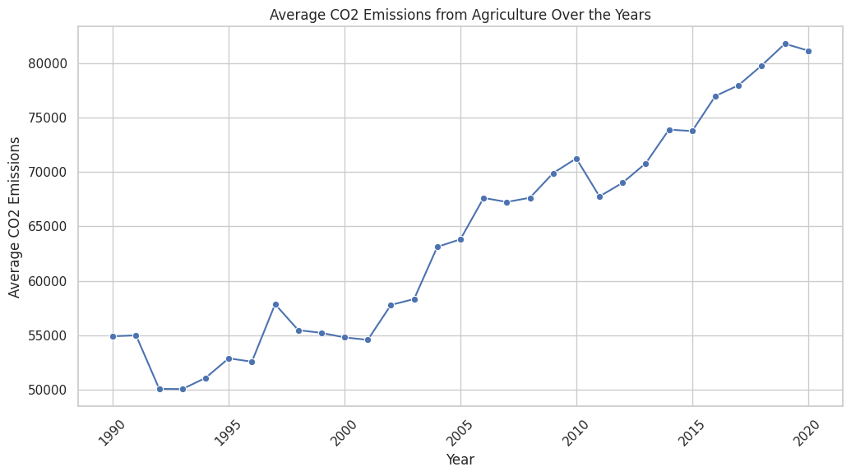
Line Plot

Slide 23
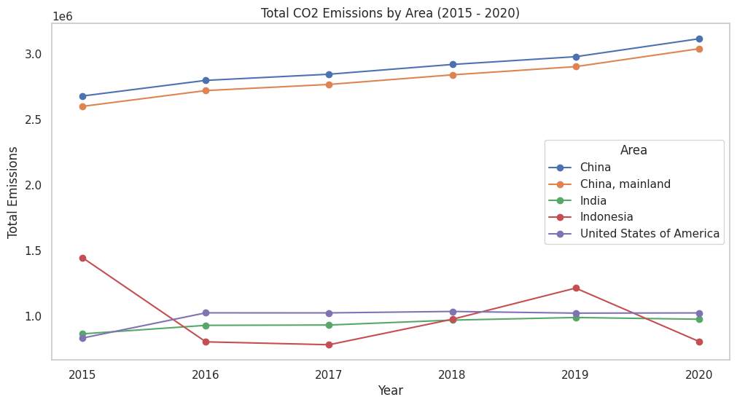
Combination Line Plot

Slide 24
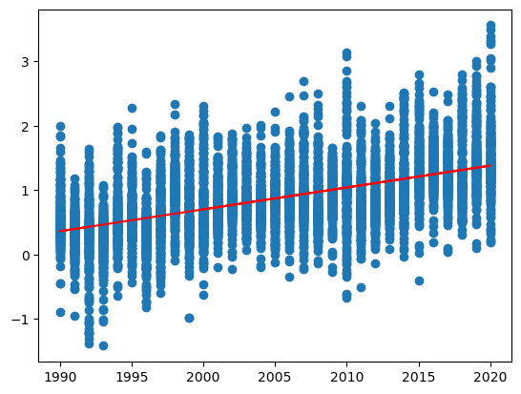
Regression Analysis

Slide 25
Overview bullet points
Do you know what helps you make your point crystal clear? Lists like this one:
They’re simple
You can organize your ideas clearly
You’ll never forget to buy milk!
And the most important thing: the audience won’t miss the point of your presentation

Slide 26
04
Model Evaluation
You can enter a subtitle here if you need it

Slide 27
Overview bullet points
Do you know what helps you make your point crystal clear? Lists like this one:
They’re simple
You can organize your ideas clearly
You’ll never forget to buy milk!
And the most important thing: the audience won’t miss the point of your presentation

Slide 28
Overview bullet points
Do you know what helps you make your point crystal clear? Lists like this one:
They’re simple
You can organize your ideas clearly
You’ll never forget to buy milk!
And the most important thing: the audience won’t miss the point of your presentation

Slide 29
05
Model Comparison
You can enter a subtitle here if you need it

Slide 30
Overview bullet points
Do you know what helps you make your point crystal clear? Lists like this one:
They’re simple
You can organize your ideas clearly
You’ll never forget to buy milk!
And the most important thing: the audience won’t miss the point of your presentation

Slide 31
06
Conclusion
You can enter a subtitle here if you need it

